Slide 1









GROUP 9
ADVENTURE QUEST
An AI-Assisted Interactive Storytelling Game

Slide 2





Members
MAISHA RAHMAN
RUHAMA RAHMAN
MOHONA HAQUE
SHEIK MEHEDI

Slide 3






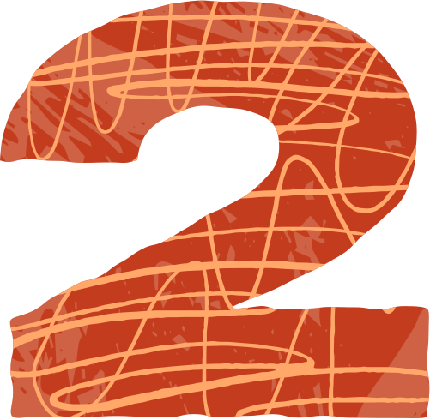

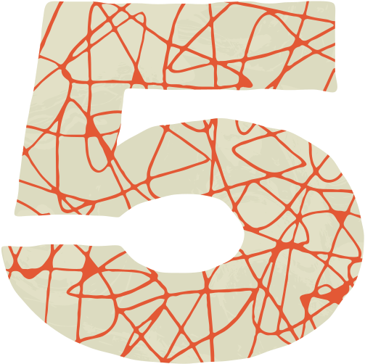




TODAY'S AGENDA
Rules of the Game
Introduction
Graph and Gameplay Visualization
Game Design
Factor Graph Basics
Conclusion

Slide 4


INTRODUCTION
The project is an interactive adventure game built with Tkinter, designed to go beyond traditional if-else branching. Instead, it applies Factor Graphs to represent the game’s logic, where variables capture the game state and factors define the rules for transitions. This modular structure allows the game to manage decisions and outcomes more flexibly, making it easier to expand and adapt.

Slide 5




GAME
DESIGN
Nodes include:
Player HP
Enemy HP
Player Location (Forest, Cave, River, Treasure)
Inventory
Factors define transitions between these nodes:
Combat Factor – connects Player HP and Enemy HP.
Movement Factor – connects Player Location to possible new locations.
Treasure Factor – connects Player Location and Inventory.

Slide 6

FACTOR GRAPH BASICS
Variables: PlayerHP, EnemyHP, Location, Inventory
Factors: Combat, Movement, Treasure
Variables = State
Factors = Rules / Logic

Slide 7
RULES OF THIS GAME
Combat Factor Rules
If the player attacks, the enemy’s HP is reduced by random damage.
If the player defends, the player’s HP decreases but with reduced damage.
If EnemyHP ≤ 0 → player wins the battle.
If PlayerHP ≤ 0 → game ends in defeat.
Movement Factor Rules
If PlayerLocation = Forest → player can move to Cave or River.
If PlayerLocation = Cave → player may encounter an enemy.
If PlayerLocation = River → player may find alternate paths.
Treasure Factor Rules
If PlayerLocation = Treasure → add “Treasure” item to Inventory.
If defeated in combat → add “Broken Gear” to Inventory.

Slide 8
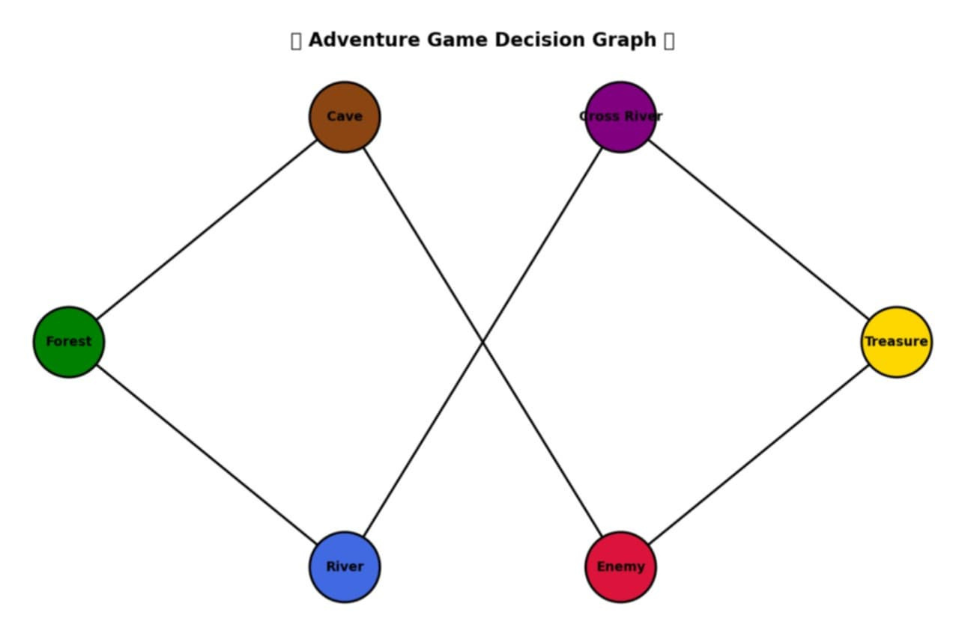
GRAPH VISUALIZATION

Slide 9
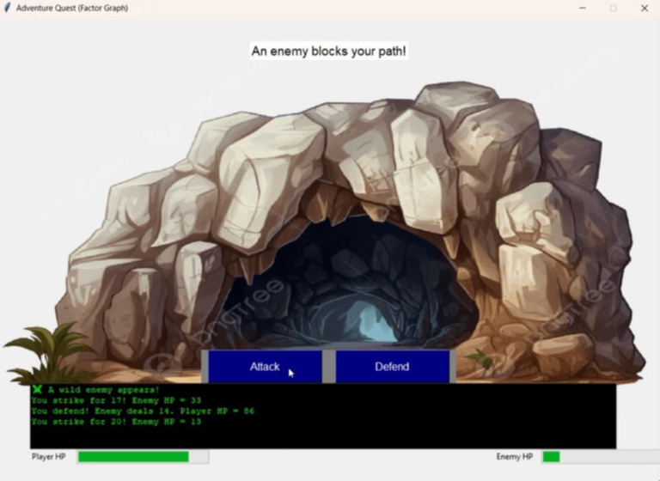
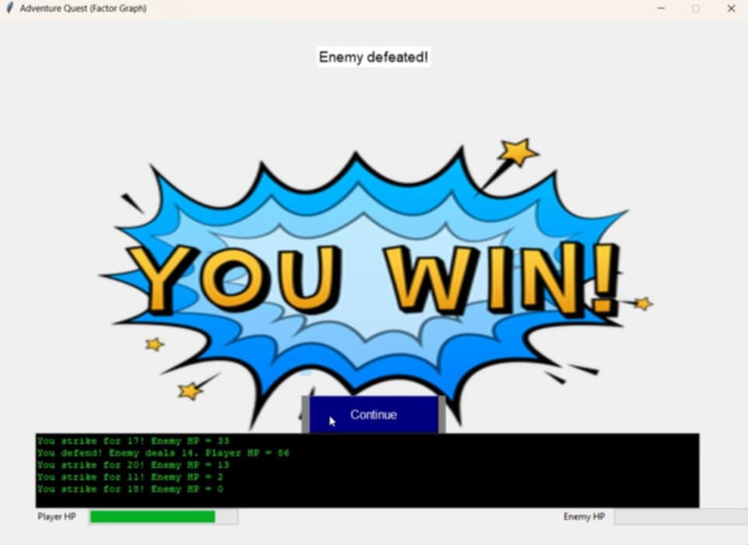
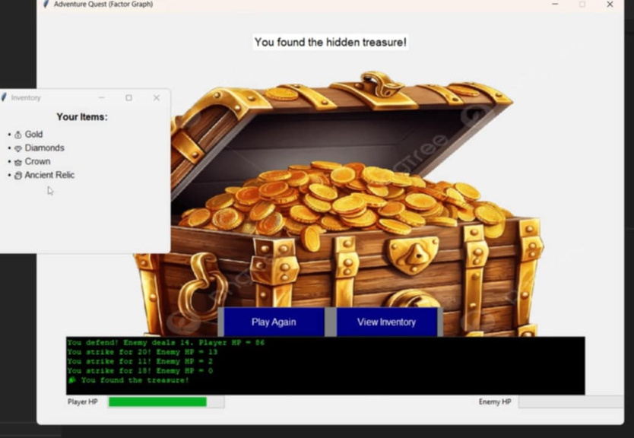
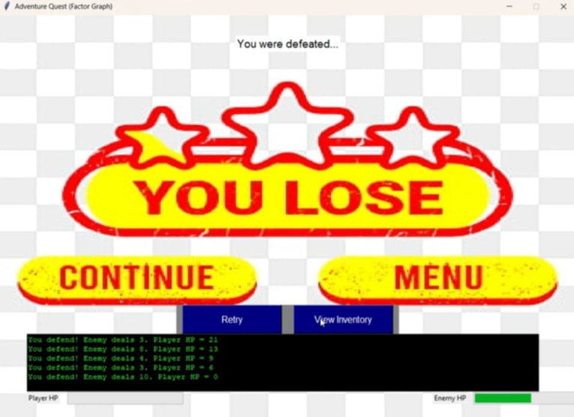
GAMEPLAY VISUALIZATION

Slide 10


CONCLUSIONS
This project shows how factor graphs make game design modular and flexible by separating state (variables) from rules (factors). They simplify mechanics like combat, movement, and treasure collection while keeping the system scalable. In the future, more puzzles, enemies, and interactions can be added easily.

Slide 11


THANK YOU!

